Slide 1
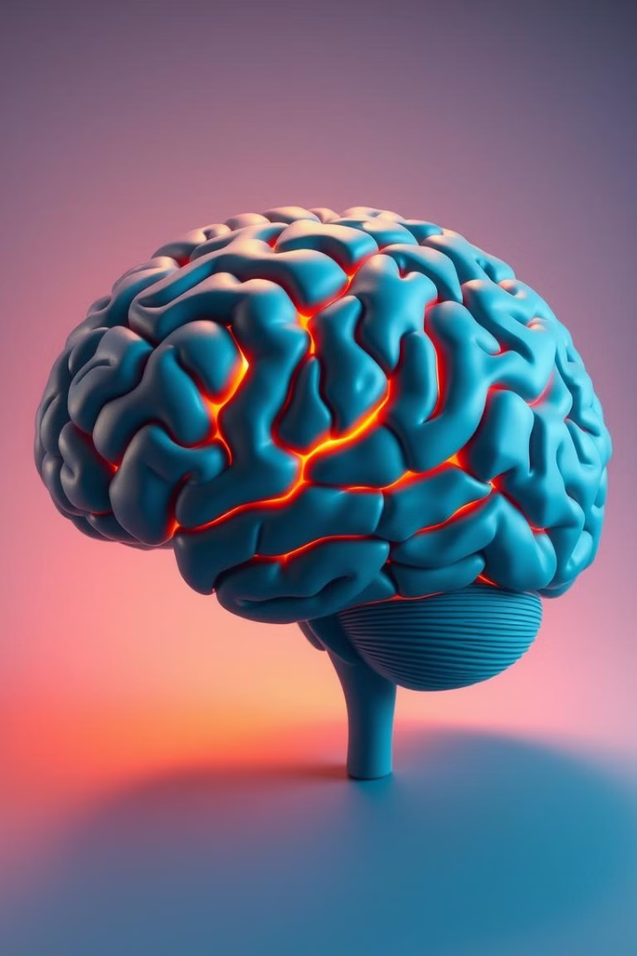
BRAIN
Brain is the control tower of higher mental processes like perceiving, reasoning, problem solving and thinking.
CNS is surrounded by cerebrospinal fluid for protection from external shock.
Larger portion of brain-cerebrum.
Cerebrum-left hemisphere + right hemisphere. Each hemisphere divided into-frontal lobe, parietal lobe, temporal lobe and occipital lobe.

Slide 2
FOREBRAIN
Highest region and largest part of brain.
Thalamus
Hypothalamus
Limbic System
Also called brain's relay station.
Regulate blood pressure, heart rate, sexual desire, body temperature and appetite.
It include hippocampus(memory)amygdala(regulate emotions like anger and fear) and septum(pleasurable emotions).
Through thalamus signals reach the cerebellum to maintain body balance and coordination.
Also involved in motivational and emotional behavior and considered as hub of emotions.
Damage to thalamus can affect a person's sleeping. Working patterns, attention and learning.
Stimulation of hypothalamus can result in violent behavior, sexual arousal and fear.

Slide 3
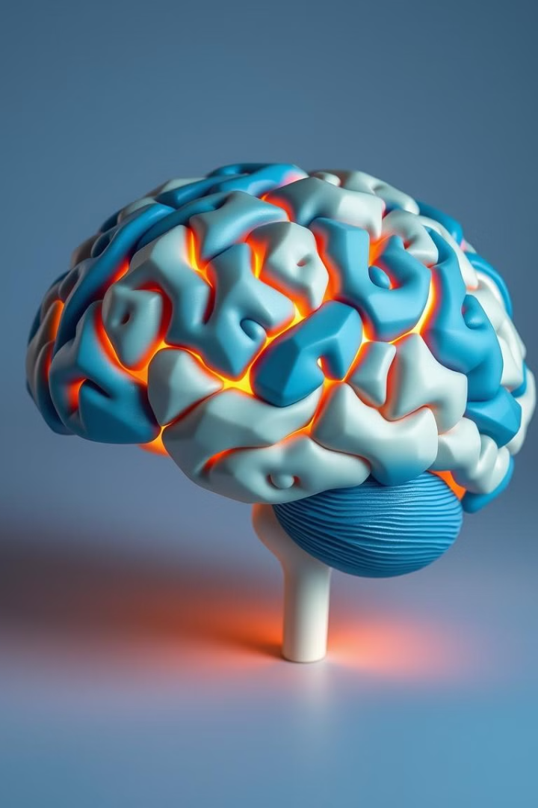
Basal Ganglia
Corpus Callosum
helps in muscle contraction and relaxation.
set of neurons connecting two hemispheres.
Cerebrum
largest portion of brain. Generally persons with intellectual disability has smaller size of cerebrum and lesser folds.

Slide 4
MIDBRAIN
Act as relay center for incoming messages from ears and eyes.
It connects forebrain and hindbrain through sensory and motor impulses.
Divided into- tectum and tegmentum .
1.TECTUM
Located in dorsal portion of midbrain.
It consist of superior colliculi and inferior colliculi.
It helps to keep eye movements fixed on an object and to orient ears to sound even when the head moves or rotates.

Slide 5
2.TEGMENTUM
Lies beneath the tectum.
It includes rostral end of reticular formation, periaquadectal grey mater, red nucleus, substantia nigra, ventral tegmental area.
3.RETICULAR ACTIVATING SYSTEM(RAS)
It plays an important role in sleep, arousal, attention etc.
Blockage of RAS leads to unconsciousness and severe damage causes coma.

Slide 6


HINDBRAIN
Medulla Oblongata
Pons
Located under cerebellum and above spinal cord.
Largest bulge in the brain stem.
It integrates the movement of body's left and right sides and nerves going to other areas of brain.
It regulates cardiovascular system, respiration and skeletal muscle tone.
Injury in lower portion leads to arrest of respiration and circulation .
Involved in sleep and arousal mechanism.
the death due to head injury in accidents occur because of this reason.
Excess intake of alcohol or heroin affect functioning of medulla.

Slide 7

Cerebellum
Located at the back of the head.
It helps in coordination of activities like walking, running, dancing etc.
Damage to cerebellum cause problems in movements and postures.
Jerky movements in older peoples are due to improper functioning of cerebellum.

Slide 8
PSYCHOLOGY AND SENSATION
SENSORY PROCESS-NORMAL AND ABNORMAL
Sensation is defined as the process of the sensory organs transforming physical energy into neurological impulses.
Sensation is possible by proper functioning of receptors, afferent nerve fibers and endings in higher processing centers in the brain.
Receptors convert environmental energy into the language of nervous system and the process is called transduction.

Slide 9
Certain attributes of sensation are:-
1.Quality-different sensations of colour, sound, taste, smell etc. differ from one another in quality.
2.Intensity-sensation of same quality may differ in intensity as a light may be either dim or bright based on distance of stimuli.
3.Duration-the sound or sight lasts for two seconds feel differently from a sound or sight that last ten seconds.
4.Extensity-the sensation from a small illuminated area is different from sensation a broader area.
5.Local sign-sensations differ from the areas stimulated.

Slide 10
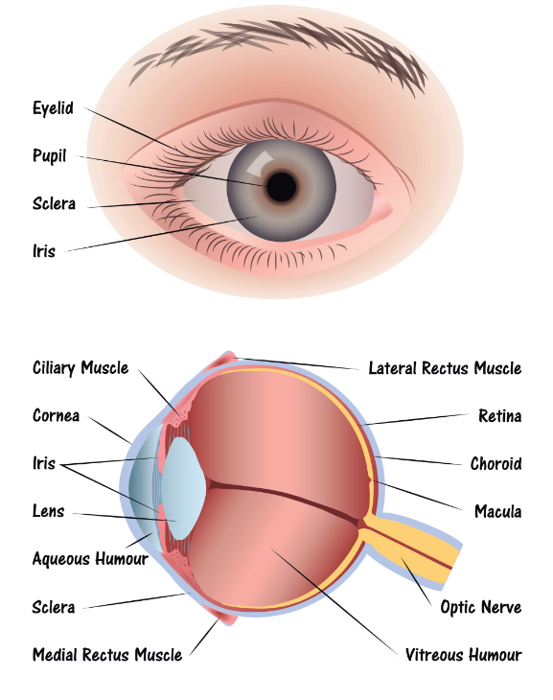
VISUAL SENSATION
It is estimated that we use visual sensation approximately 80 percent of our transaction with the world.
HUMAN EYE
Visual sensation starts when light enters the eyes and stimulates visual receptors.
Light enters the eye through a tough, glassy covering called cornea.
Then it passes through a transparent jelly like substance known as aqueous humor.
It then passes through lens and there is a transparent substance that fill the space behind lens called vitreous humor.

Slide 11
The cornea and lens converge the light rays passing through the vitreous chamber and finally forming an image in the retina.
Rods-sensitive only to brightness of light or scotopic vision.
Cones-for photopic or daylight vision.
Fovea-a small circular region , also known as yellow spot which is responsible for clearest images.
Colour vision-according to trichromatic theory by Helmholtz, retina consist of three different cones-red, green or blue and any colour can be obtained by an appropriate mixture of these wavelengths.

Slide 12
ABNORMAL VISUAL PROCESSES
People with normal color vision-trichromats.
Deficiency in color vision cause color blindness.
color blindness is genetically inherited and most common in males.
People who are totally color blind have dysfunctional cones- monochromats . (all color appear as grey)
Person who is insensitive to one of two color pairs, red-green or blue-yellow.
Defects in visual acuity-blurring of vision, blindness.
Defect in visual field-tunnel vision in glaucoma.
Senile cataract.

Slide 13
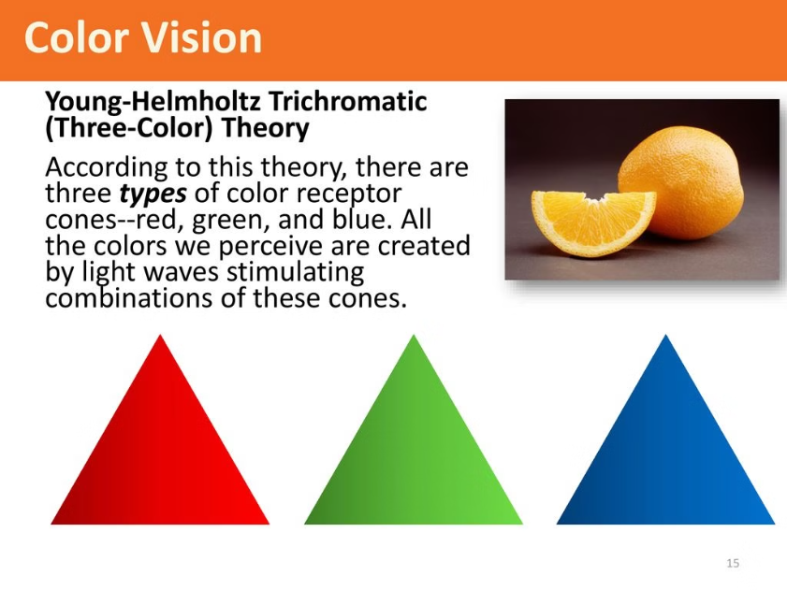
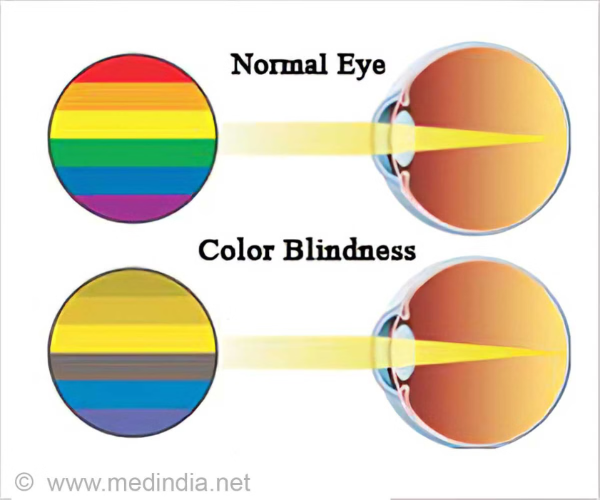

Slide 14
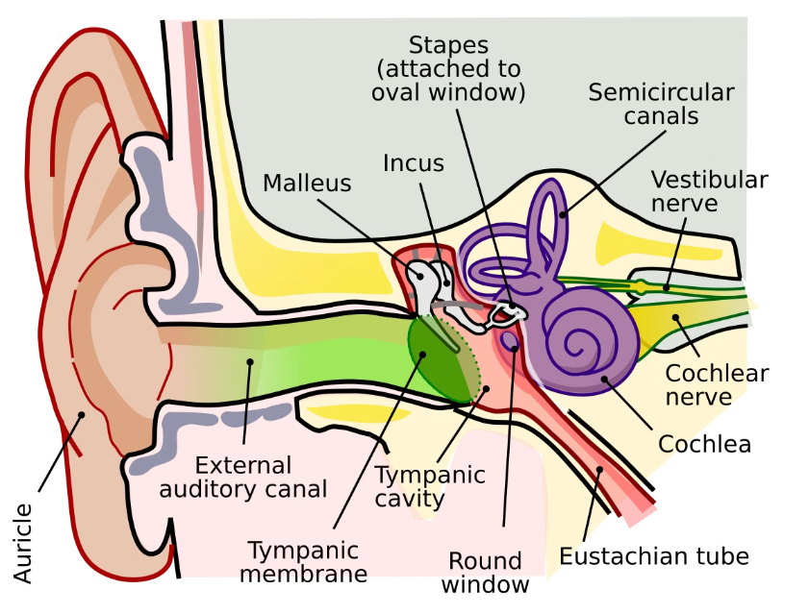
AUDITORY SENSATION
Auditory sensation begin when sound enters our ear and stimulate the organ of hearing.
1.External ear-includes pinna(collect sound waves) and auditory meatus(canal protected by hair and wax).
2.Middle ear-tympanum(thin membrane highly sensitive to sound vibrations), connected to pharynx with help of eustachian tube.
Then vibration pass to malleus, incus and stapes.
3.Inner ear-contain cochlea(contain hair cells that act as receptors for hearing.

Slide 15
ABNORMAL AUDITORY SENSATION
Loss of hearing.
Tinnitus-ringing/roaring in the ear.
Presbycusis-certain frequencies of sound affected(due to ageing).

Slide 16
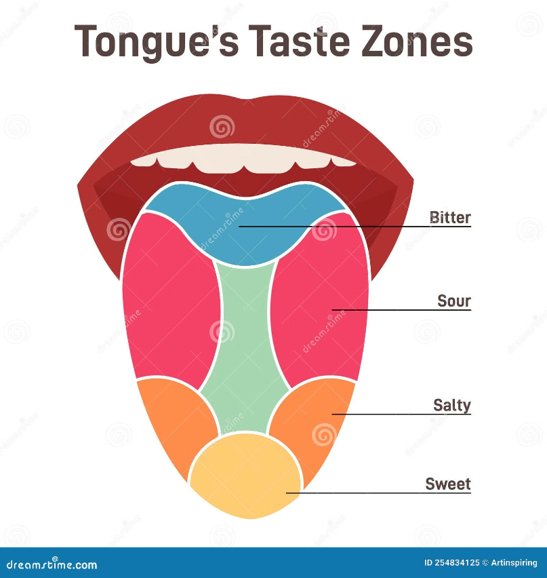
SENSE OF TASTE/GUSTATION
The sensory receptors for taste are located inside small bumps on the tongue known as papillae.
Sour receptor-located on the side of the tongue.
bitter receptor-back of tongue.
Sweet and salt receptor-front of the tongue.

Slide 17
ABNORMALITY IN SENSE OF TASTE
1.Hypogeusia-diminished sense of taste.
2.Ageusia-complete loss of taste.
3.Dysgeusia-alteration in the perception of taste.

Slide 18
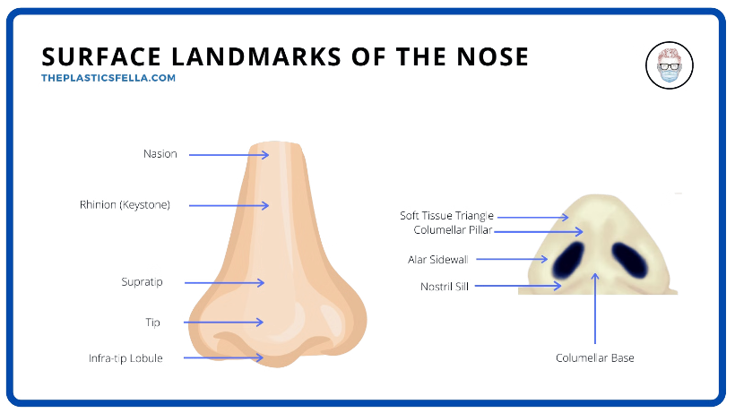
SENSE OF SMELL/OLFACTION
The stimulus for smell sensation consists of molecules of various substances contained in the air.
They enter the passage where they dissolve in moist nasal tissues.
Smell receptors are neurons and their cell bodies are embedded in the epithelium.

Slide 19
ABNORMALITY IN SENSE OF SMELL
Loss of sensation of smell-anosmia
Misinterpretation of specific smell- parosmia
SENSE OF TOUCH/CUTANEOUS SENSE
Skin is the largest sensory organ that produces different sensations.
Tactile sense produce sensation of touch, warmth, cold and pain.
The receptors of touch are not evenly distributed in our skin, that is why some areas like face, finger tips etc. are most sensitive that other such as legs.

Slide 20
ABNORMALITY IN SENSE OF TOUCH
Paresthesia-felt as pins and needles, tingling and numbness.
Anesthesia-loss of sensations in a part of the surface of the body.

